Slide 1
FYI Book Request
Lending Library Program

Slide 2
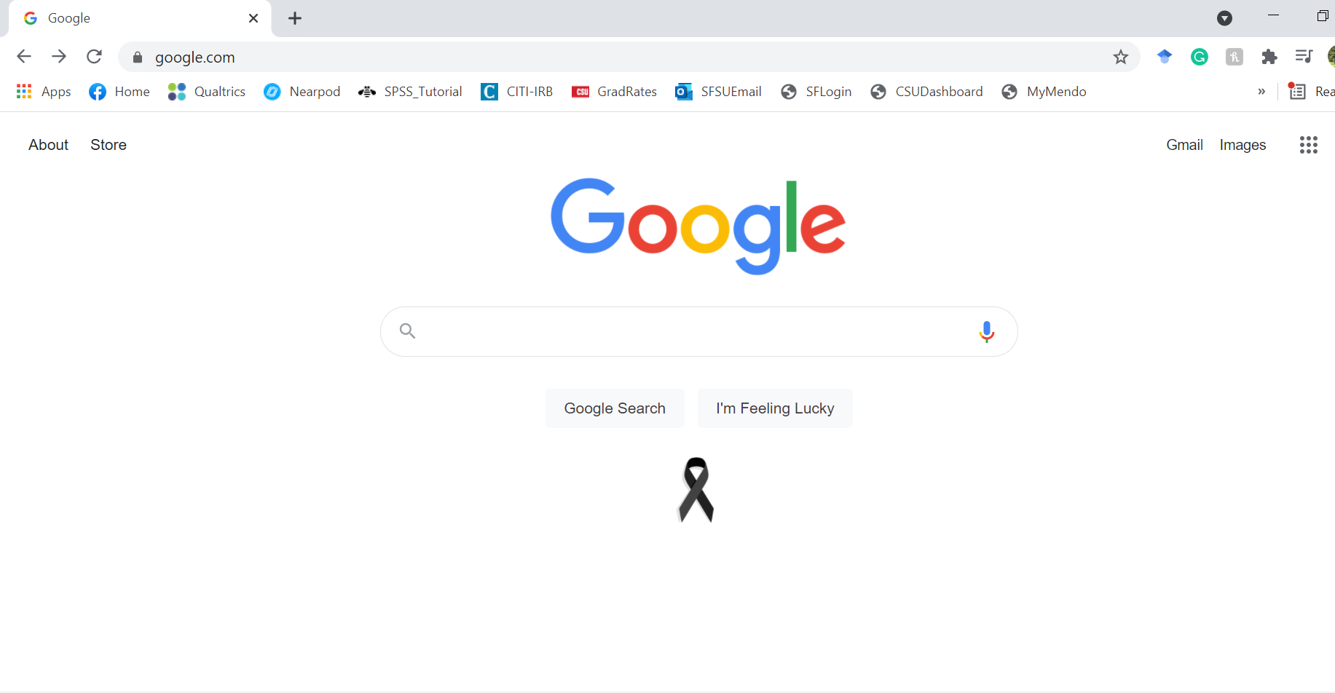
Step 1:
Open a search engine browser such as Google

Slide 3
Step 2:
Type in “Mendocino College Library” into the search

Slide 4
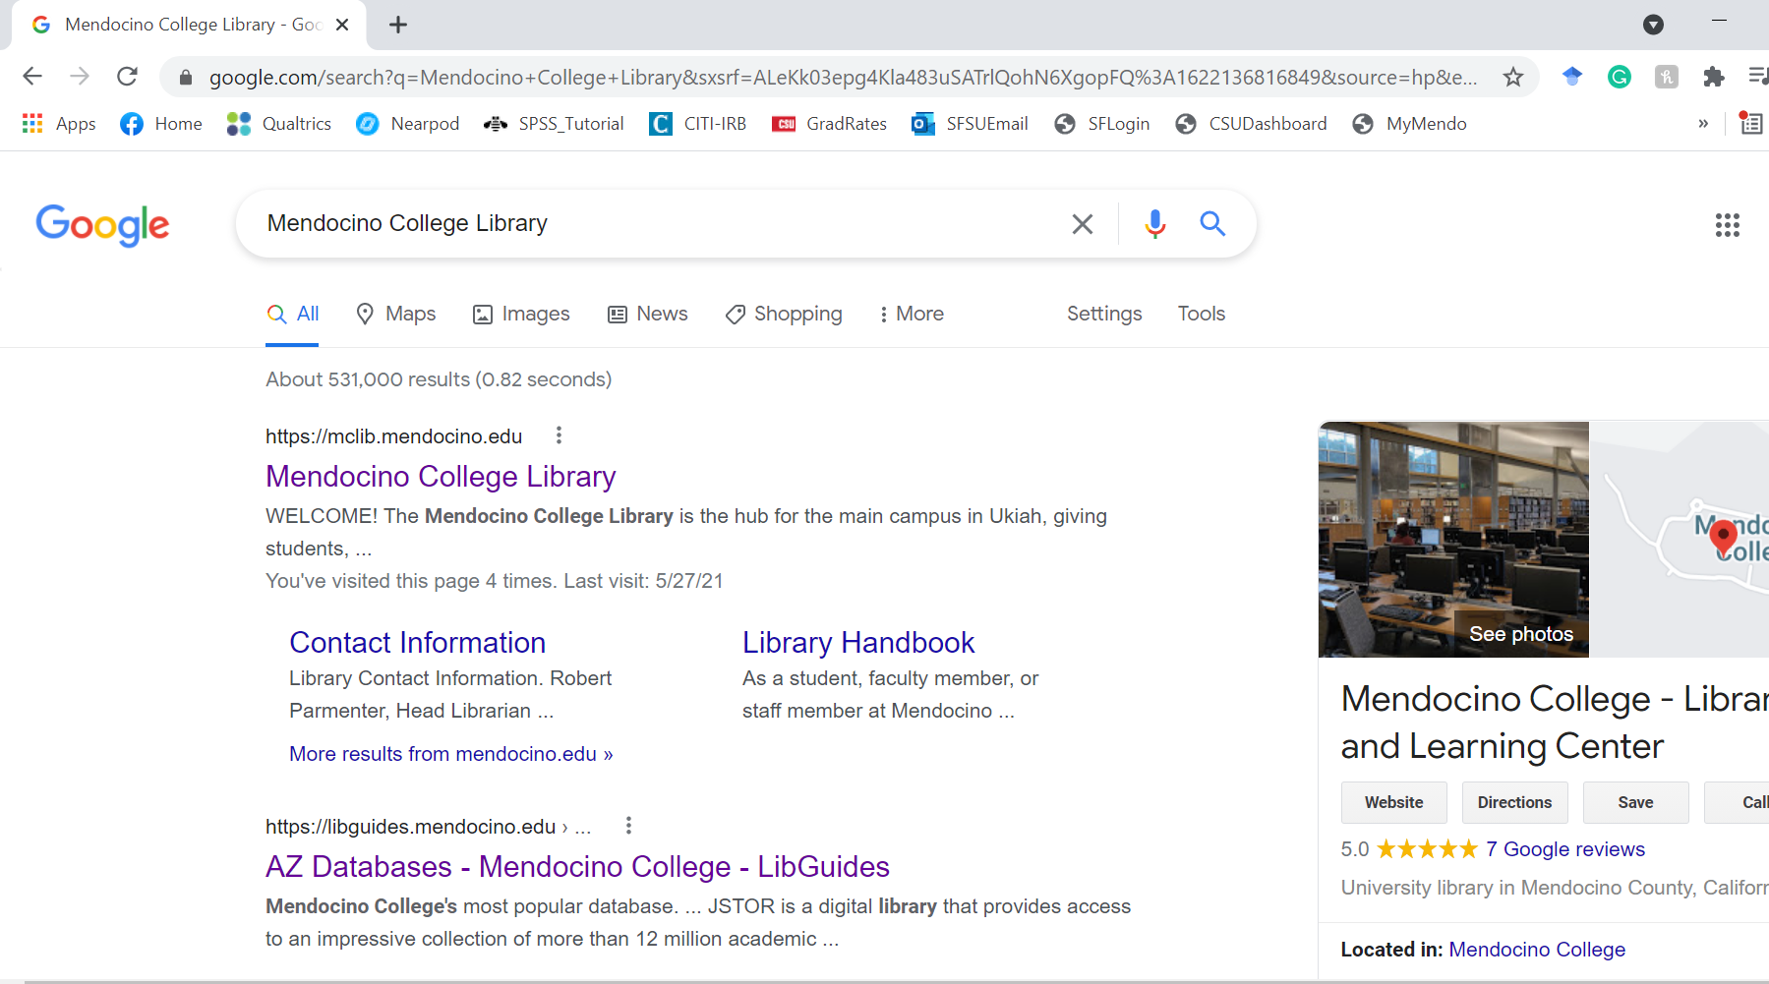
Step 3:
Out of the search options, select the first link titled “Mendocino College Library”

Slide 5
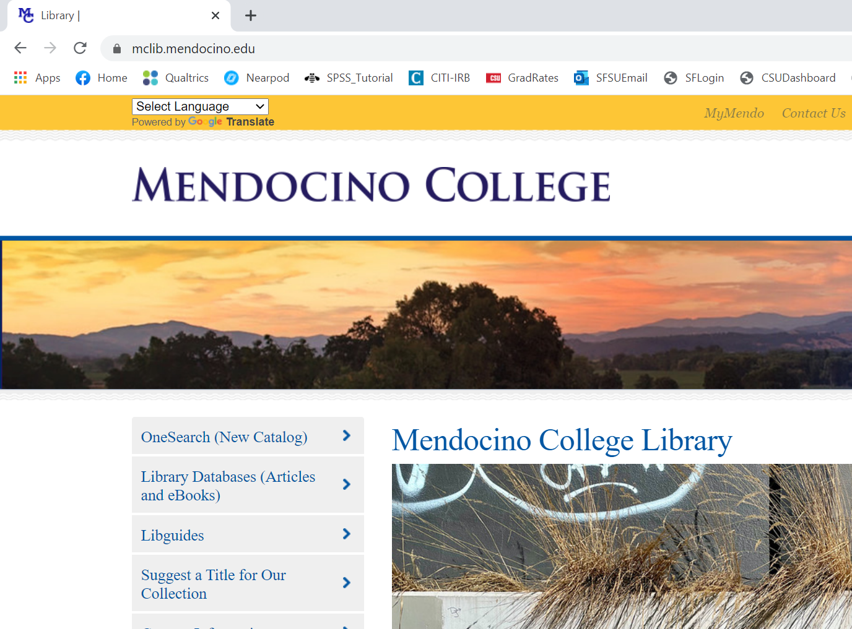
Step 4:
Once on the library home page, click on the top button title “One Search (New Catalog)”

Slide 6
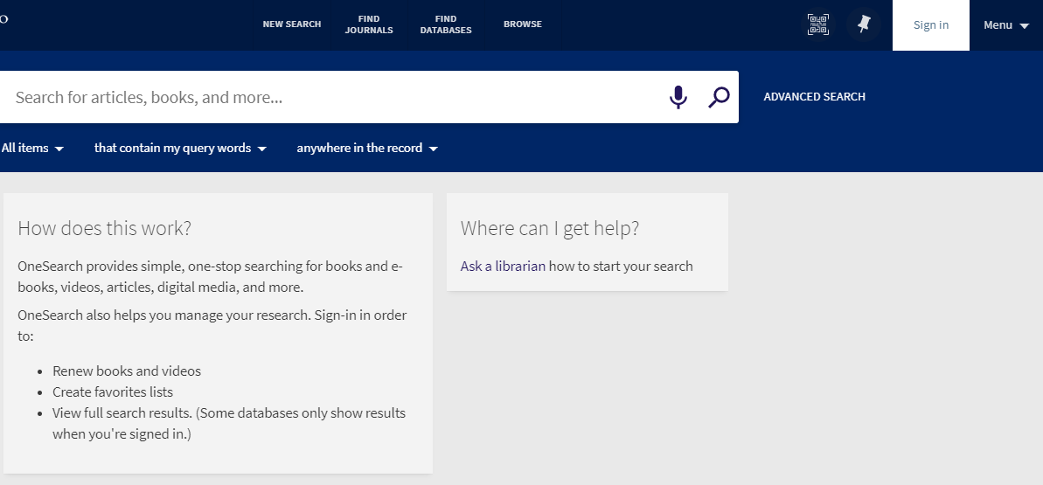
Step 5:
Sign into the database using your My Mendo login credentials

Slide 7
Step 5a:
Sign in by selecting the student/staff login button

Slide 8
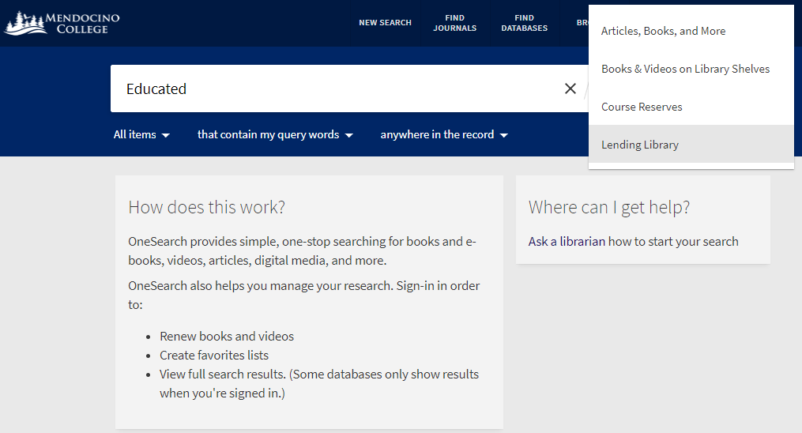
Step 6:
Enter the title of the book you are searching for, then select “Lending Library” and hit the search button

Slide 9
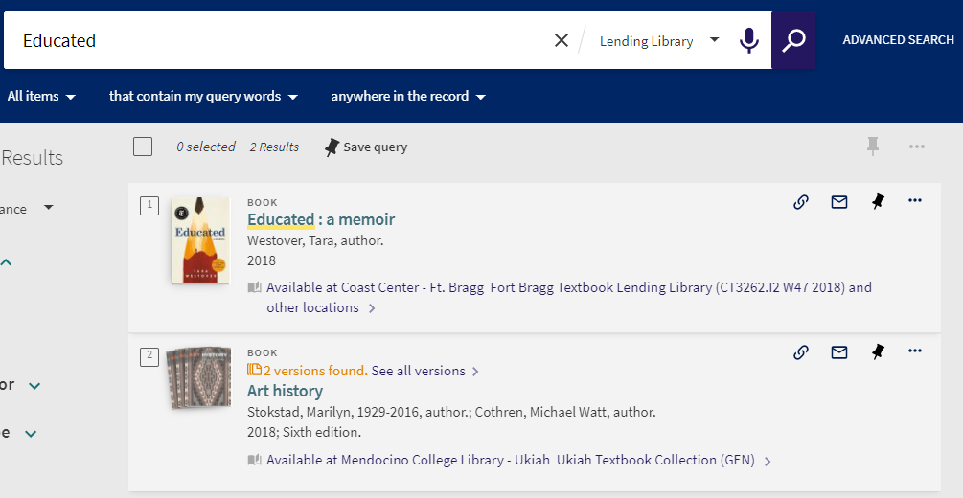
Step 7:
Once you find the book you need, click on the book title

Slide 10
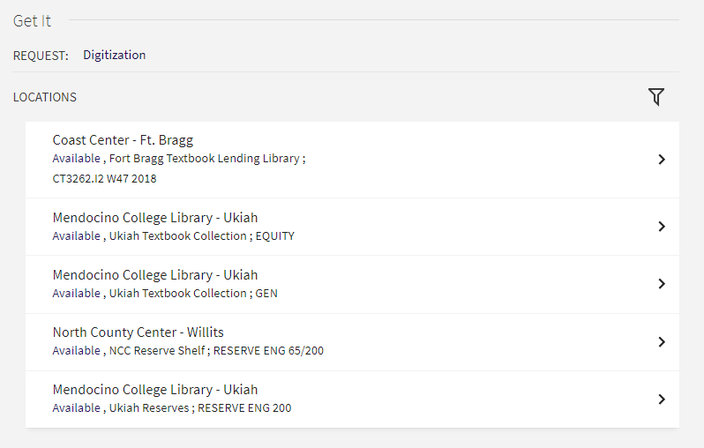
Step 7a:
You will then be taken to a screen with more info about the book

Slide 11
Step 7b:
You may notice there are multiple versions available.
Select the “GEN” option to filter the FYI program listings.

Slide 12
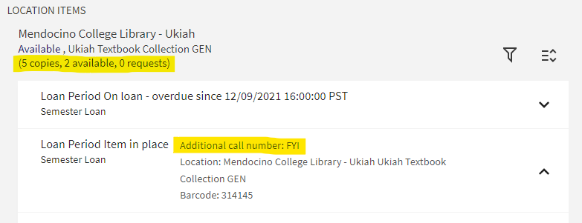
Step 8:
As long as an FYI copy is available, you can request the book. If the book has a digital request form, follow the next steps. If it does not, skip to step 11.

Slide 13
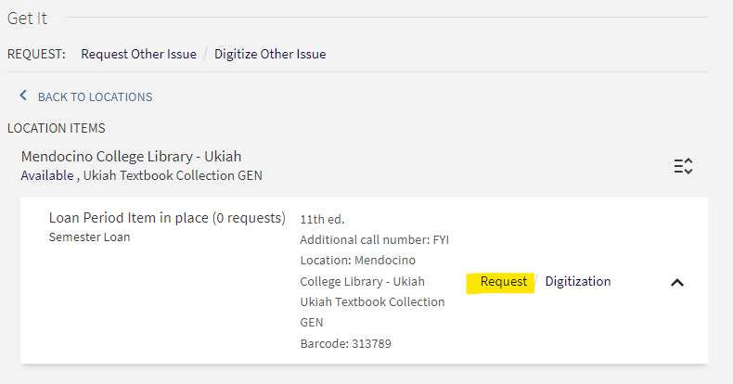
Step 9:
Hit ‘request’ on the copy you want.

Slide 14
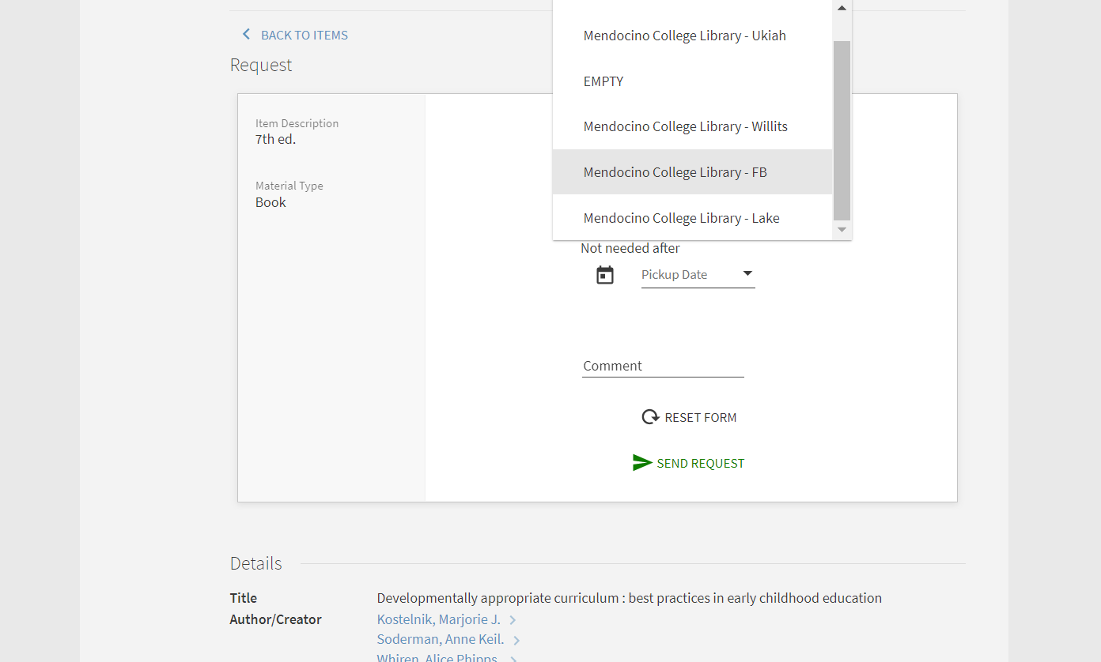
Step 9a:
Once you hit ‘request’ this box will appear. Fill out the request according to which campus you want to pick the book up at...

Slide 15
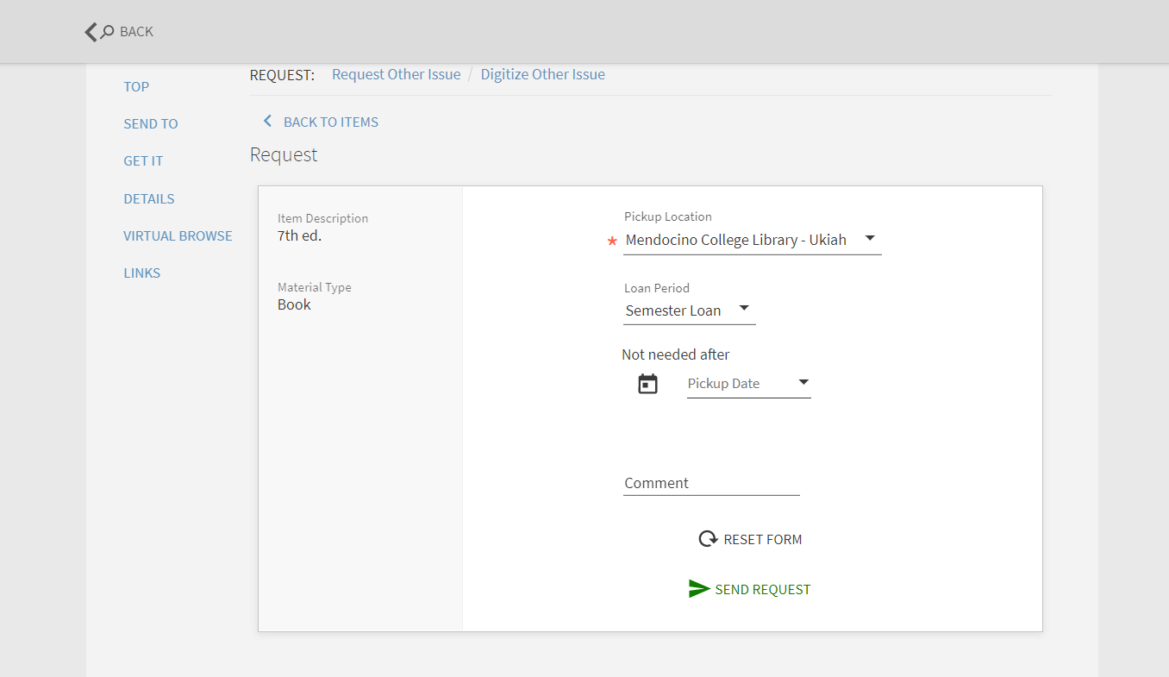
Step 9b:
… and select ‘Semester Loan’, under loan period.
You do not need to enter anything under “pickup date” or “comment.”

Slide 16
Step 9c:
Once everything looks good, hit ‘Send Request’

Slide 17
Step 10 (request confirmed):
Once you hit ‘Send Request’, you should receive an email to your mendocino email address.
You will need to wait until you receive a follow up email from the library saying your request has been processed AND that your book is ready for pick up at the campus you selected.

Slide 18
Step 11 (no digital request form):
If there is no digital form available, email the library at libraryhelp@mendocino.edu with the following information:
Course number, name, and section number
(ex: ENG-200-5657, English Composition)
Book title, author, and edition
Your name and student ID
The library will contact you once your request is received and processed.

Slide 19
Reminder:
Please make sure you return the book(s) no later than the end of the term.

Slide 20
If you have any questions, comments, or concerns please feel free to reach out to the FYI via email at:
fyi@mendocino.edu

