Slide 1
Caring Classrooms & Communities:
Supporting Mendocino County Students’ Mental Health Needs Now & Beyond the Pandemic
Vincent Poturica vpoturica@mendocino.edu

Slide 2
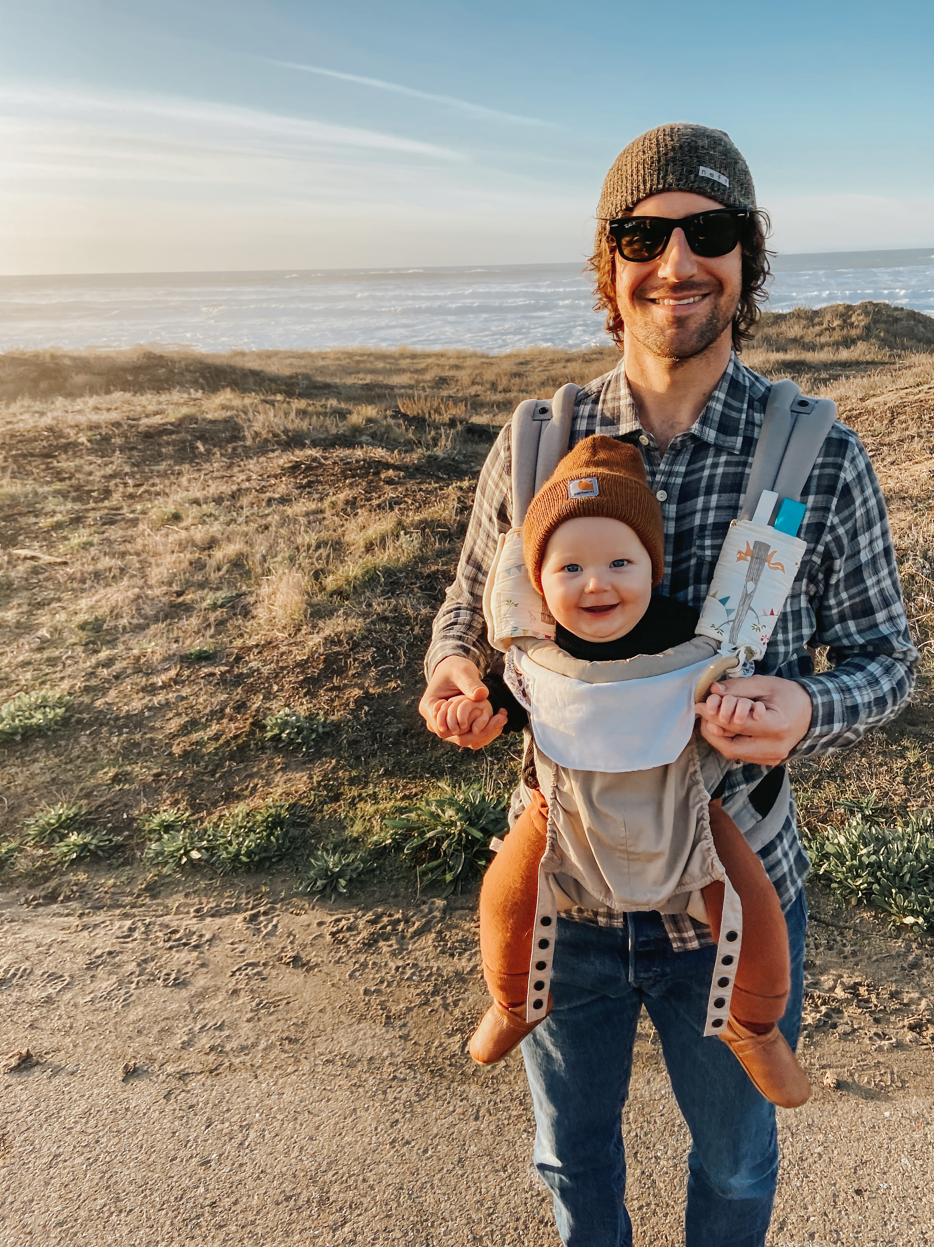
A little bit about me …

Slide 3
“Take a Breath” Activity
de Castro, John. “Reduce Anxiety and Depression in College Student with an Online Mindfulness Virtual Community.” Contemplative Studies, 31 Oct. 2020, contemplative-studies.org/wp/index.php/2020/10/31/reduce-anxiety-and-depression-in-college-student-with-an-online-mindfulness-virtual-community/. Accessed 10 Apr. 2021.

Slide 4
Presentation Roadmap
How are Mendocino County students’ experiences with trauma and mental health challenges different from those of students elsewhere in the state and the country?
What can educators do to better support students experiencing toxic stress and other mental health issues?
How can Mendocino County provide more consistent support resources?

Slide 5
What is trauma?
“Trauma is the body’s response to an event, a series of events, or an ongoing circumstance that is experienced by the individual as physically or emotionally harmful or life threatening and that has lasting effects on how the individual relates to the world. [It] impacts our wellbeing similar[ly] to experiences of scarcity and toxic stress” (Menakem).
Ruff, Amy. “The Polyvagal Theory and Contemplative Practices.” Portland State University, 22 Jan. 2021, Virtual Teaching Innovation Conference: Contemplative Practice in Higher Education. Address.

Slide 6
How do we measure trauma? (We track ACEs.)
“Adverse Childhood Experiences (ACEs) are potentially traumatic events that occur in childhood (0-17 years):
experiencing violence, abuse, or neglect
witnessing violence in the home or community
having a family member attempt or die by suicide
Also included are aspects of the child’s environment that can undermine their sense of safety, stability, and bonding, such as growing up in a household with:
substance misuse
mental health problems
instability due to parental separation or household members being in jail or prison”
“Adverse Childhood Experiences (ACEs).” Centers for Disease Control and Prevention, 2020, cdc.gov/violenceprevention/childabuseandneglect/acestudy/index.html. Accessed 2 May 2020.

Slide 7
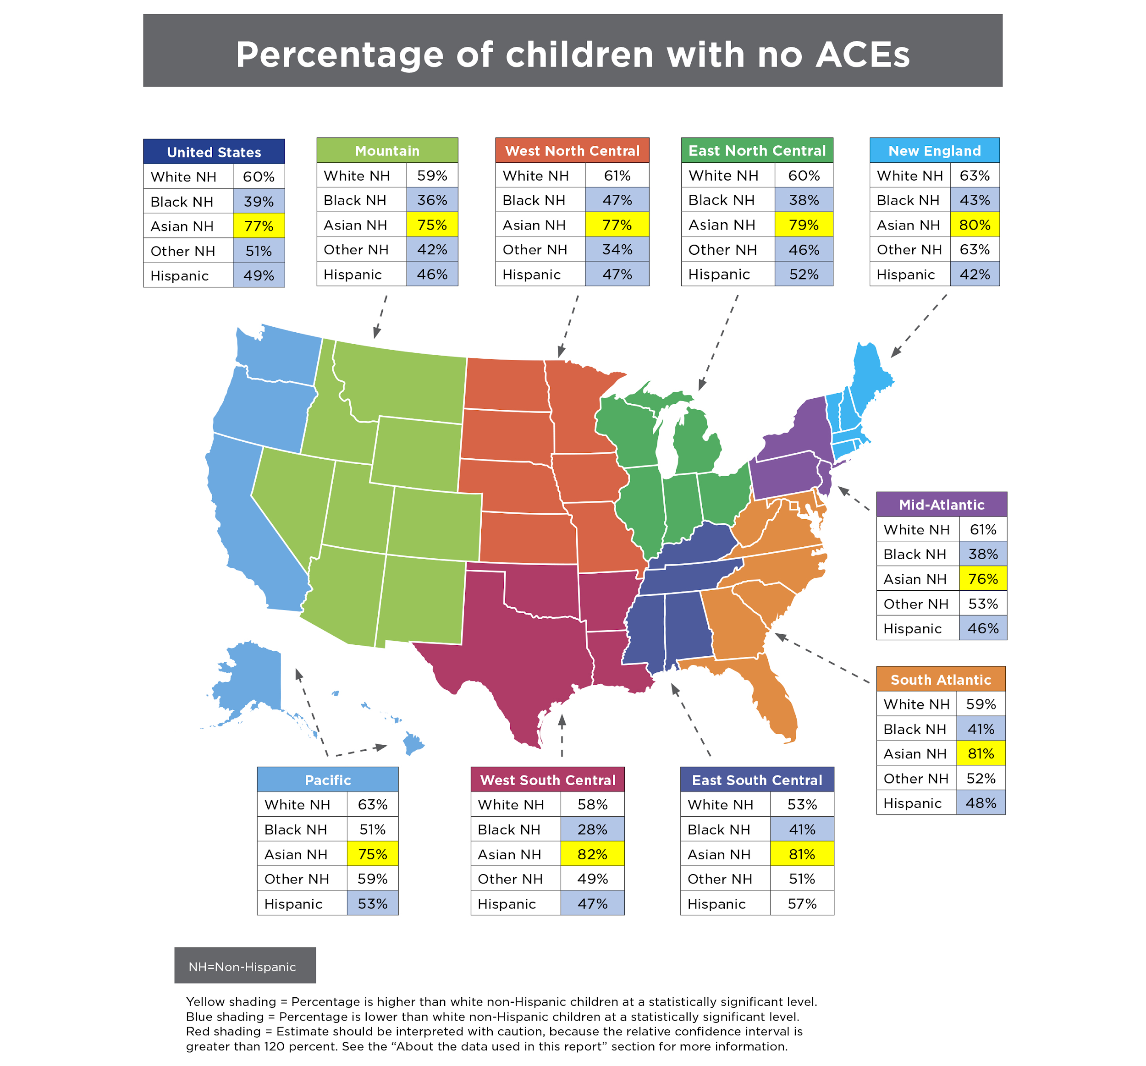

Slide 8
“Adverse Childhood Experiences (ACEs).” Centers for Disease Control and Prevention, 2020, cdc.gov/violenceprevention/childabuseandneglect/acestudy/index.html. Accessed 2 May 2020.

Slide 9
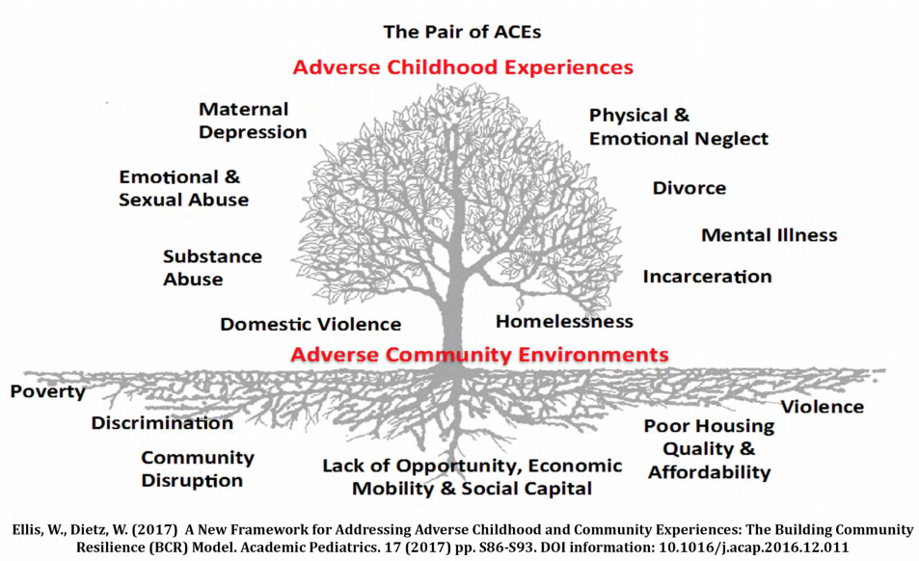

Slide 10
Connecting the Dots Between Trauma- and Rural-Related Equity Gaps
“But experts on trauma say awareness is growing in rural California about the underlying challenges students—as well as rural staff and educators—face at home and how to best address them.
The turning point came after the San Francisco-based Center for Youth Wellness in 2014 conducted a survey across California to probe exposure to ‘adverse childhood experiences’ … validat[ing] what many county residents had suspected.”
Romney, Lee. “California rural education network launches to help isolated teachers share resources.” EdSource, 7 Oct. 2018, edsource.org/2018/california-rural-education-network-launches-to-help-isolated-teachers-share-resources/603083. Accessed 15 Jan. 2020.

Slide 11
Out of 58 California counties, where do you think Mendo ranks in terms of residents with at least one ACE?

Slide 12
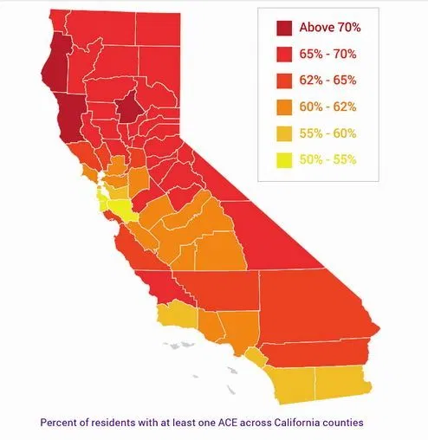
California Counties with Highest Number of ACEs

Slide 13
California Counties with Highest Number of ACEs
Butte County: 76.5% of residents have 1 or more ACEs
Mendocino & Humboldt Counties: 75.1% of residents have 1 or more ACEs
A Hidden Crisis: Findings on Adverse Childhood Experiences in California. Center for Youth Wellness, 2014, centerforyouthwellness.org/wp-content/themes/cyw/build/img/building-a-movement/hidden-crisis.pdf. Accessed 12 Apr. 2020.

Slide 14
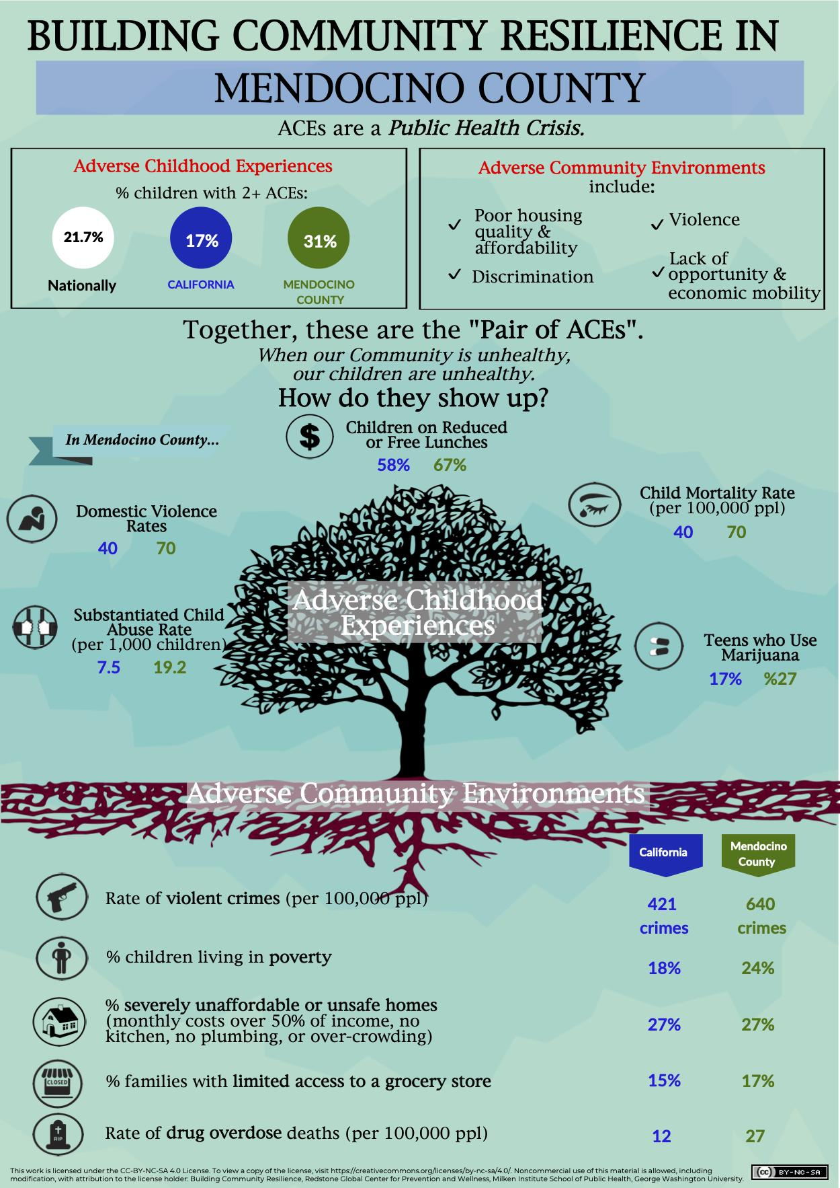

Slide 15
What is toxic stress & how does it relate to ACEs?
“ACEs research shows the correlation between early adversity and poor outcomes later in life. Toxic stress explains how ACEs ‘get under the skin’ and trigger biological reactions that lead to those outcomes … the term “toxic stress” describe[s] extensive, scientific knowledge about the effects of excessive activation of stress response systems on a child’s developing brain, as well as the immune system, metabolic regulatory systems, and cardiovascular system. Experiencing ACEs triggers all of these interacting stress response systems. When a child experiences multiple ACEs over time—especially without supportive relationships with adults to provide buffering protection—the experiences will trigger an excessive and long-lasting stress response, which can have a wear-and-tear effect on the body, like revving a car engine for days or weeks at a time.
[Besides ACEs, there are also] community and systemic causes—such as violence in the child’s community and experiences with racism and chronic poverty—because the body’s stress response does not distinguish between overt threats from inside or outside the home environment, it just recognizes when there is a threat, and goes on high alert.”
“ACEs and Toxic Stress: Frequently Asked Questions.” Center for the Developing Child, Harvard Univeristy, 2021, developingchild.harvard.edu/resources/aces-and-toxic-stress-frequently-asked-questions/. Accessed 12 Apr. 2021.

Slide 16
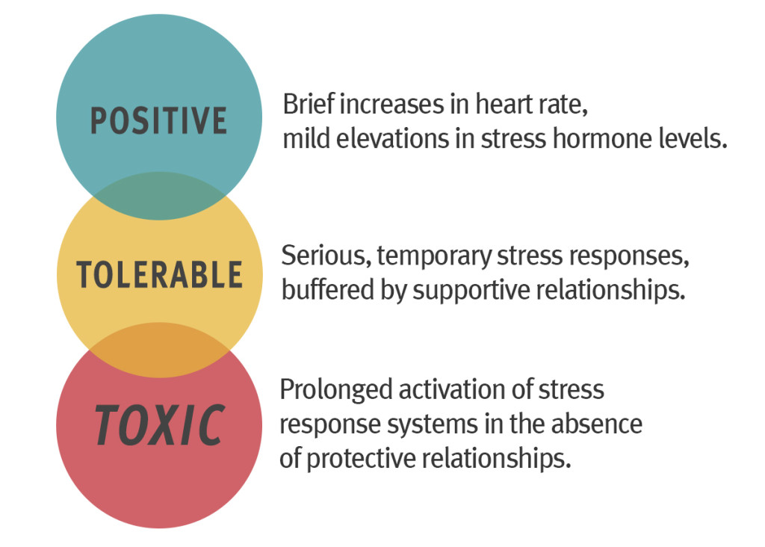
“Toxic Stress.” Center for the Devloping Child, Harvard Univeristy, 2021, developingchild.harvard.edu/resources/aces-and-toxic-stress-frequently-asked-questions/. Accessed 12 Apr. 2021.

Slide 18
Unique Adverse Aspects of Mendocino County
Unregulated, undergound economy
Historical trauma, particularly the genocide & disenfranchisement of local tribes
Natural disasters, especially wildfires
Cultural norms, such as rugged individualism
“Top 20 Largest California Wildfires.” CAL FIRE, Nov. 2020, fire.ca.gov/media/4jandlhh/top20_acres.pdf. Accessed 13 Apr. 2021.

Slide 19
COVID-19 Pandemic
Mass death of 562,741 people (& counting) in the U.S. & 209,702 (& counting) in Mexico
Changing public health guidance & community norms throughout the county, state, & nation
Social & physical isolation
“Coronavirus Resource Center.” John Hopkins University School of Medicine, 13 Apr. 2021, coronavirus.jhu.edu/. Accessed 13 Apr. 2021.

Slide 20
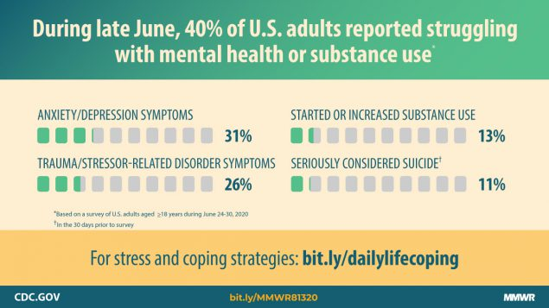
Czeisler, Mark, et al. “Mental Health, Substance Use, and Suicidal Ideation During the COVID-19 Pandemic—United States, June 24-30, 2020.” Centers for Disease Control and Prevention, 14 Aug. 2020, www.cdc.gov/mmwr/volumes/69/wr/mm6932a1.htm. Accessed 13 Apr. 2021.

Slide 21
“The percentage of respondents who reported having seriously considered suicide in the 30 days before completing the survey (10.7%) was significantly higher among respondents aged 18–24 years (25.5%), minority racial/ethnic groups (Hispanic respondents [18.6%], non-Hispanic black [black] respondents [15.1%]), self-reported unpaid caregivers for adults§ (30.7%), and essential workers (21.7%).”
Czeisler, Mark, et al. “Mental Health, Substance Use, and Suicidal Ideation During the COVID-19 Pandemic—United States, June 24-30, 2020.” Centers for Disease Control and Prevention, 14 Aug. 2020, www.cdc.gov/mmwr/volumes/69/wr/mm6932a1.htm. Accessed 13 Apr. 2021.

Slide 22
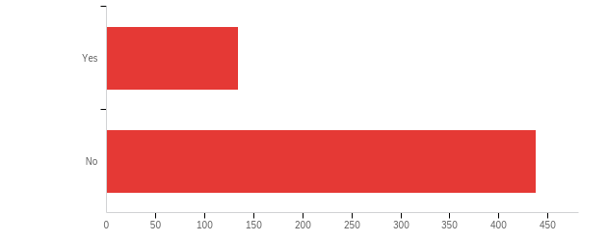
Mendocino College “Fall 2020 Needs Survey”
Q15 - Do you need academic/personal counseling or socio-emotional support during the quarantine? (572 responses)
Answer | % | Count
Yes | 23.43% | 134
No | 76.57% | 438
Total | 100% | 572
Flores, Minerva. “Fall 2020 Needs Survey.” Mendocino College, Fall 2020.

Slide 23
Mendocino College “Fall 2020 Needs Survey”
Q6 - Is there anything else you need in order to successfully complete the Fall 2020 semester remotely?
“Mental health counseling or referral services for primary mental health care … any resources available for single struggling parents with mental illness”
“Just for the world to stop being so crazy. Can you believe we've been pretty much locked in our houses for 6 months?”
“Right now I'm extremely depressed and I'm having trouble not bursting into tears several times a day.”
“Follow up academic meetings with counselors to make sure … my mental health isn't dragging me down from completing my classes”
“Emotional support.”
“I hope to get through the tough times this Fall. Thank you for your help.”
Flores, Minerva. “Fall 2020 Needs Survey.” Mendocino College, Fall 2020.

Slide 24
What can educators do to better support students experiencing toxic stress and other mental health issues?

Slide 25
Students need to feel safe & supported. So we need to create classes in which they do.

Slide 26
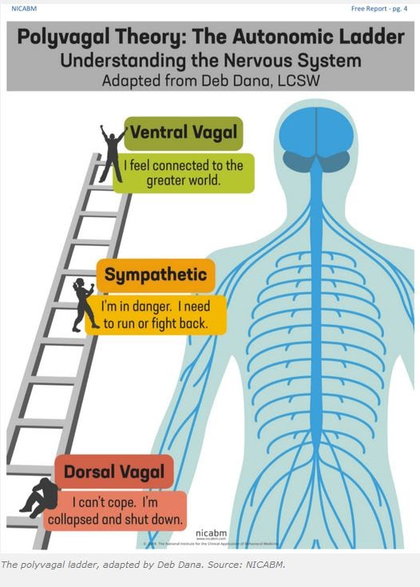
We want our students to be grounded in the parasympathetic system, so they feel connected in our classes and better able to learn.
Ruff, Amy. “The Polyvagal Theory and Contemplative Practices.” Portland State University, 22 Jan. 2021, Virtual Teaching Innovation Conference: Contemplative Practice in Higher Education. Address.

Slide 28
Be Flexible & Transparent
Deadlines & policies (especially related to grading)
Co-created assignments
Clear, specific course guidelines
Individual conferences/check-ins
Extra-credit opportunities
Grinberg, Kita. “The Transformational Classroom: Healing Practices for Student Growth.” Teachers on Teaching, Mendocino College, 7 March 2020. Address.

Slide 29
Be Consistent
(When possible) ritualize teaching practices & class community norms (for example, circle discussions, low-stakes formative assessments, scaffolding summative assessment, individual conferences/check-ins)
Model the habit of asking questions & quickly responding to students’ inquiries
Reach out to those who are falling behind

Slide 30
Be Mindful, Intentional, & Kind
Be aware of & open about your & your students’ stressors
(When possible) incorporate mindfulness-based centering activities (movement, breath, & attention)
Frequently use inclusive, strengths-based language
Create space/opportunity for students to build connections & cultivate social support
Regularly encourage students to use (updated) campus services
Frank, Jennifer L., and Bidyut K. Bose. “Effectiveness of a School-Based Dynamic Mindfulness Program on Adolescent Stress.” Niroga Institute, niroga.org/education/research/frank-bose_summary_2studies.pdf. Accessed 15 Apr. 2020.
Karatekin, Canan. “Adverse Childhood Experiences (ACEs), Stress and Mental Health in College Students.” Stress & Health: Journal of the International Society for the Investigation of Stress, vol. 34, no. 1, Feb. 2018, pp. 36–45. EBSCOhost, doi:10.1002/smi.2761. Accessed 15 May 2020.

Slide 31
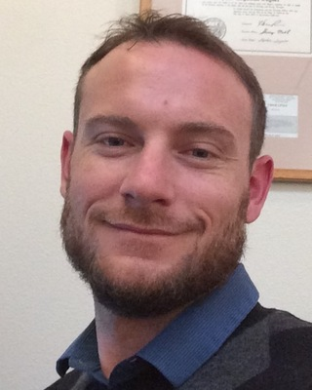
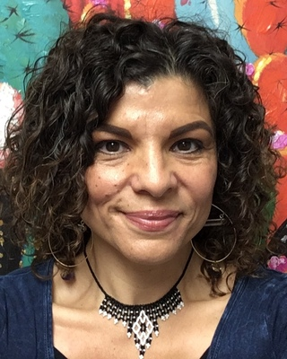
Mendocino College Mental Health Counselors
Jeremy (Owen) Lawyer jlawyer@mendocino.edu (707) 391-7452
Rachel Young ryoung@mendocino.edu (707) 694-2450

Slide 32
Be Teachable & Inclusive
Listen & empower—include students in the class- & institution-level decision-making
Use data to inform class- & institution-level decision-making
(When possible) attend trainings, classes, and workshops
Connect with teaching mentors
Whitebrook, Marcy. “Mentoring and Coaching: Distinctions in Practice.” Center for the Study of Child Care Employment, UC Berkeley, 1 Mar. 2016, cscce.berkeley.edu/mentoring-and-coaching-distinctions-in-practice/. Accessed 15 April 2020

Slide 33
Be Teachable & Inclusive, Cont.
Connect with teaching mentors
“The primary role of a mentor or coach is to provide support and encouragement so that a teacher has someone to rely on and turn to. Trust is essential for a close relationship, along with willingness by both partners to reveal themselves and to risk making mistakes”
Whitebrook, Marcy. “Mentoring and Coaching: Distinctions in Practice.” Center for the Study of Child Care Employment, UC Berkeley, 1 Mar. 2016, cscce.berkeley.edu/mentoring-and-coaching-distinctions-in-practice/. Accessed 15 April 2020

Slide 34
=
EQUITY
EQUALITY
=
DIVERSITY
Montes, Rebecca & Center for Urban Education. “What Do We Mean by Equity?.” Mendocino College, Spring 2020, Equity Professional Development Series. Address.

Slide 35
EQUALITY imagines an equal world.
“I treat everyone equally”
Montes, Rebecca & Center for Urban Education. “What Do We Mean by Equity?.” Mendocino College, Spring 2020, Equity Professional Development Series. Address.

Slide 36
But the world isn’t equal.
Poorly-Funded Schools
Less-Skilled Teachers
Counselor Ratios of 1:1000
Truncated Curriculum
Scholarships
Educated Parents
Private Tutors
AP Credit
Mental Health & Other School Resources
Highly Skilled Teachers & Counselors

Slide 37
And there is bias and institutional racism and classism.
Implicit Bias
Institutional Racism & Classism
Predominantly White & High Income
Predominantly Marginalized Racial/Ethnic &/or Low-Income Groups

Slide 38
What does it mean to be equity-minded?
Noticing racial inequities
Acknowledging that practices may not be working
Understanding inequity as a dysfunction of structures, policies, & practices
Questioning assumptions, recognizing stereotypes, & implicit biases
Taking action to eliminate inequity
Institutionally Focused
Systemically Aware
Race Conscious
Evidence Based
Equity Advancing
Montes, Rebecca & Center for Urban Education. “What Do We Mean by Equity?.” Mendocino College, Spring 2020, Equity Professional Development Series. Address.
Notes:
BREAK FOR QUESTIONS…..

Slide 39
Be Equity-Minded
Connect students to (updated) campus & community resources
Remove barriers (for example, costly textbooks & supplies, unnecessary placement tests, & internet/electronic device needs)
Design culturally relevant assignments & activities
Cultivate antiracist classroom communities
Learn about & reform your own & your institution’s biases & inequities

Slide 40
Shifting Our Mindset
“Instead of saying, ‘Here’s the service, come and get it,’ it’s: ‘Here’s the service, how can we get it to you?’” (Molina)
Molina, Jennifer. Lost Days: A journey into chronic absenteeism in rural Butte County, California. EdSource, 30 May 2019, edsource.org/2019/lost-days-chronic-absenteeism-in-rural-california-video/613080. Accessed 8 Jan. 2020.

Slide 41
Shifting Our Mindset
“Butte Thrives [a coalition run out of the Butte County offices of First 5] is promoting trainings on how institutions that serve children, including schools and school districts, can become ‘trauma-informed,’ shifting the tone from a punitive or blaming one to one more sensitive to the underlying causes of a student’s behavior.
‘Instead of saying, “What’s wrong with you?” or “What did you do?”’ Bauer explained, ‘ask “What has happened?”’”
Romney, Lee. “California rural education network launches to help isolated teachers share resources.” EdSource, 7 Oct. 2018, edsource.org/2018/california-rural-education-network-launches-to-help-isolated-teachers-share-resources/603083. Accessed 15 Jan. 2020.

Slide 42
How can Mendocino County provide more consistent support resources?

Slide 43
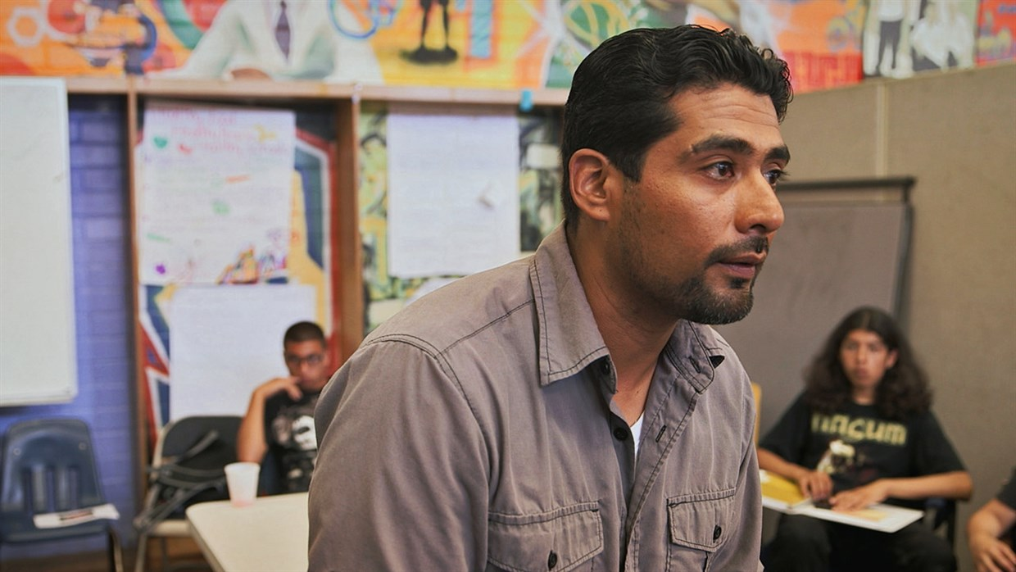
"Grit alone isn't going to cut it. You can sit there and tell me all you want, 'Hey man, pick yourself up by the bootstraps.' But if I was born without any straps on my boots, how am I supposed to pick myself up? … Job training, mentoring, counseling, teaching young people to learn from their mistakes instead of criminalizing them.“
Rios, Victor. “Help for kids the education system ignores.” TED, 17 Nov. 2016, www.ted.com/talks/victor_rios_help_for_kids_the_education_system_ignores/up-next?language=en. Accessed 15 Mar. 2021.

Slide 44
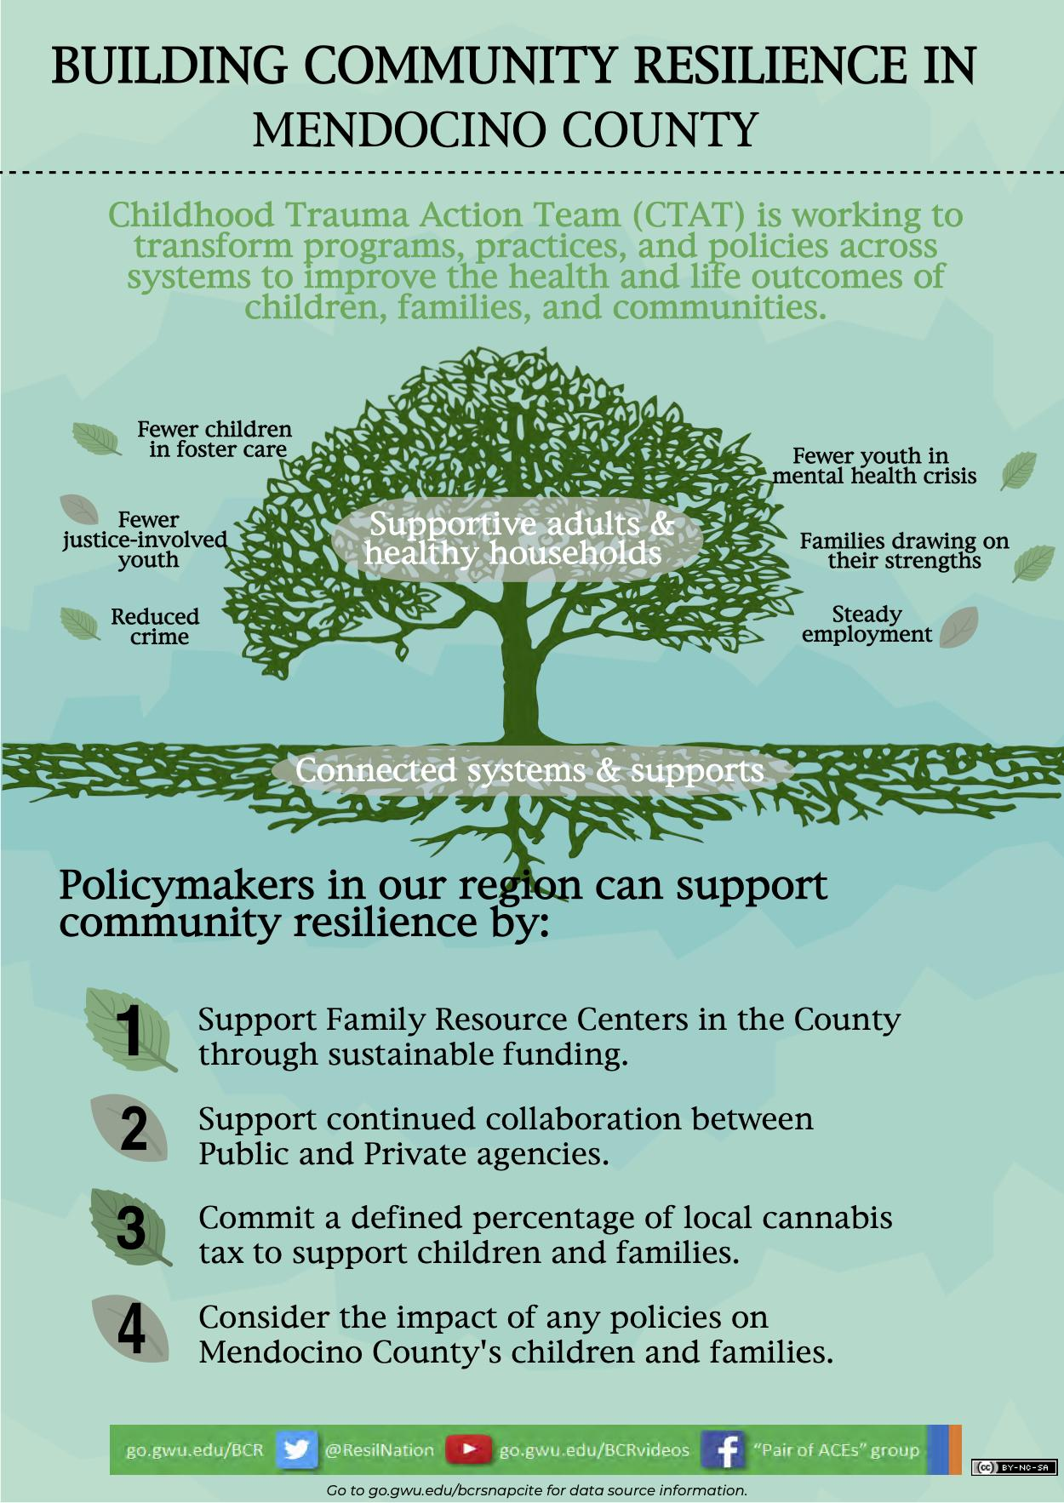

Slide 46
Current Balance (12/9/20) for Measure B (Mental Health Treatment Act)
Amount | Min 25% (Operations) | Max 75% (Facilities)
$20,670,442 | $5,115,146 | $15,555,295
“Measure B Budget to Date as of 12/9/2020.” Mendocino County, www.mendocinocounty.org/home/showpublisheddocument?id=39480. Accessed 12 Apr. 2021.

Slide 47
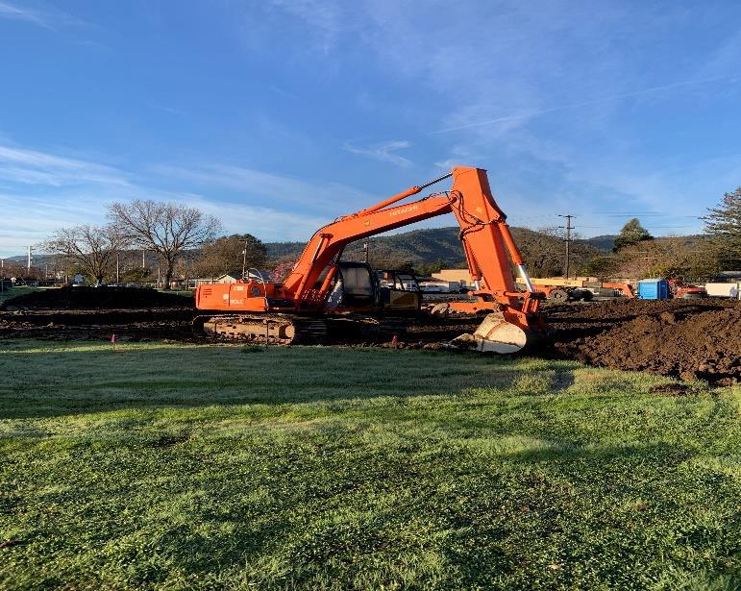
Provide More Updates
About Measure B Projects
Crisis Residential Treatment Facility
Mobile Response Team Pilot (last report from March 2020)
Crisis Assessment and Psychiatric Hospitalization Aftercare
Community Education, Awareness, and Support
Psychiatric Hospital Facility
“Measure B Projects.” Mendocino County, www.mendocinocounty.org/community/mental-health-oversight-committee/projects. Accessed 12 Apr. 2021.

Slide 48
Update Existing County Resources
The current “Mendocino County Recovery Resources Map” (for Substance Use) is from November 2012
The “Philosophical Principals–Goals of Mendocino County Mental Health Program” were last revised in June 2012
The last meeting minutes from the Cultural Diversity Committee (for Behavioral Health & Recovery Services) are from December 5, 2018
“Mendocino County Recovery Resources Map,” “Philosophical Principals–Goals of Mendocino County Mental Health Program,” “Cultural Diversity Committee.” Mendocino County, www.mendocinocounty.org/home/showpublisheddocument?id=2486. Accessed 12 Apr. 2021.

Slide 49
What can I do? Contact the Mendocino County Board of Supervisors.
Collectively: BOS@mendocinocounty.org / (707) 463-4221
Individually:
Glenn McGourty (District 1)—mcgourtyg@mendocinocounty.org
Maureen Mulheren (District 2)—mulherenm@mendocinocounty.org
John Haschak (District 3)—haschakj@mendocinocounty.org
Dan Gjerde (District 4)—gjerde@mendocinocounty.org
Ted Williams (District 5)—williamst@mendocinocounty.org

Slide 50
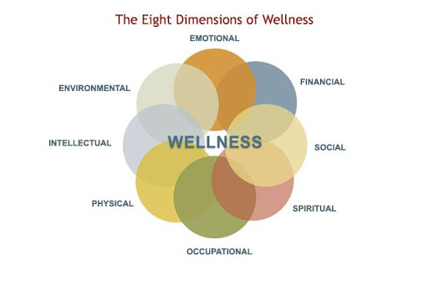
Continue to Destigmatize Mental Health
“Behavioral Health Wellness.” Virginia Department of Behavioral Health & Developmental Services, 2019, ec.aisn-demo.com/behavioral-health/behavioral-health-wellness. Accessed 13 Apr. 2021.
Oakley, Eloy Ortiz. “Call to Action Update,” California Community Colleges, www.cccco.edu/-/media/CCCCO-Website/Files/Communications/vision-for-success/dei-call-to-action-update.pdf?la=en&hash=43095848EF5C578AE9EC842BC5385D3680B8944B. Accessed 12 Apr. 2020.

Slide 51
Consider Adopting the First Two Efforts from California Community College System’s Call to Action
“On June 5, [2020,] we released a Call to Action letter where I called for our system to respond to systemic racism by urgently working to:
Conduct a system-wide review of law enforcement enforcement officers and first responder training
Host open dialogue and review [community] climate” (Oakley).
Oakley, Eloy Ortiz. “Call to Action Update,” California Community Colleges, www.cccco.edu/-/media/CCCCO-Website/Files/Communications/vision-for-success/dei-call-to-action-update.pdf?la=en&hash=43095848EF5C578AE9EC842BC5385D3680B8944B. Accessed 12 Apr. 2020.

Slide 52
What other research can we do to become more trauma-informed educators and a more trauma-informed county?
What other initiatives do we need and/or partnerships can we join to provide our students with more trauma- and mental-health-related resources?

Slide 53
References
“ACEs and Toxic Stress: Frequently Asked Questions.” Center for the Developing Child, Harvard Univeristy, 2021, developingchild.harvard.edu/resources/aces-and-toxic-stress-frequently-asked-questions/. Accessed 12 Apr. 2021.
“Adverse Childhood Experiences (ACEs).” Centers for Disease Control and Prevention, 2020, cdc.gov/violenceprevention/childabuseandneglect/acestudy/index.html. Accessed 2 May 2020.
Bailey, Thomas R., et al. Redesigning America’s Community Colleges : A Clearer Path to Student Success. Harvard University Press, 2015.
“Behavioral Health Wellness.” Virginia Department of Behavioral Health & Developmental Services, 2019, ec.aisn-demo.com/behavioral-health/behavioral-health-wellness. Accessed 13 Apr. 2021.
Butte Thrives. ACEs Connection, 2020, https://www.acesconnection.com/g/butte-county-ca-aces-connection. Accessed 16 May 2020.
CA Rural Ed Network, Butte County Office of Education, 2020, caruraled.net. Accessed 15 Jan. 2020.

Slide 54
References
“CA Rural Resource Bank.” Digital Chalkboard, 2018, mydigitalchalkboard.org/portal/default/Group/Viewer/GroupView?action=2&gid=6955. Accessed 8 Apr. 2020.
Childhood Trauma Action Team. “Building Resilience in Mendocino County.” Healthy Mendocino, 2020, drive.google.com/file/d/11hzz9x2pdQvEKrl531jm81ZsQexuAyT5/view. Accessed 16 May 2020.
Childhood Trauma Action Team. “Childhood Trauma in Mendocino County.” Healthy Mendocino, 2020, healthymendocino.org/index.php?module=Tiles&controller=index&action=display&id=110284768957532539. Accessed 16 May 2020.
"Coronavirus Resource Center.” John Hopkins University School of Medicine, 13 Apr. 2021, coronavirus.jhu.edu/. Accessed 13 Apr. 2021.
Czeisler, Mark, et al. “Mental Health, Substance Use, and Suicidal Ideation During the COVID-19 Pandemic—United States, June 24-30, 2020.” Centers for Disease Control and Prevention, 14 Aug. 2020, www.cdc.gov/mmwr/volumes/69/wr/mm6932a1.htm. Accessed 13 Apr. 2021.

Slide 55
References
de Castro, John. “Reduce Anxiety and Depression in College Student with an Online Mindfulness Virtual Community.” Contemplative Studies, 31 Oct. 2020, contemplative-studies.org/wp/index.php/2020/10/31/reduce-anxiety-and-depression-in-college-student-with-an-online-mindfulness-virtual-community/. Accessed 10 Apr. 2021.
Ellis, Wendy R., and William H. Dietz. “A New Framework for Addressing Adverse Childhood and Community Experiences: The Building Community Resilience Model.” Academic Pediatrics, vol. 17, no. 7S, 1 Sept. 2017, pp. S86-S93. academicpedsjnl.net/article/S1876-2859(16)30552-6/fulltext. Accessed 16 May 2020.
Elmhurst, Katie R., et al. “Post-Katrina undergraduate trauma education: theory, conceptualization, innovation, implementation, and proof of concept.” Traumatology, vol. 25, no 3, 2019, pp. 189-195, dx.doi.org/10.1037/trm0000170. Accessed 15 Apr. 2020.
Flores, Minerva. “Fall 2020 Needs Survey.” Mendocino College, Fall 2020.
Frank, Jennifer L., and Bidyut K. Bose. “Effectiveness of a School-Based Dynamic Mindfulness Program on Adolescent Stress.” Niroga Institute, niroga.org/education/research/frank-bose_summary_2studies.pdf. Accessed 15 Apr. 2020.

Slide 56
References
Grinberg, Kita. “The Transformational Classroom: Healing Practices for Student Growth.” Teachers on Teaching Conference, Mendocino College, 7 Mar. 2020. Address.
A Hidden Crisis: Findings on Adverse Childhood Experiences in California. Center for Youth Wellness, 2014, centerforyouthwellness.org/wp-content/themes/cyw/build/img/building-a-movement/hidden-crisis.pdf. Accessed 12 Apr. 2020.
Jones, Carolyn. “The long road to college from California’s small towns.” EdSource, 20 Dec. 2019, edsource.org/2019/the-long-road-to-college-from-californias-small-towns/621428. Accessed 8 Jan. 2020.
Karatekin, Canan. “Adverse Childhood Experiences (ACEs), Stress and Mental Health in College Students.” Stress & Health: Journal of the International Society for the Investigation of Stress, vol. 34, no. 1, Feb. 2018, pp. 36–45. EBSCOhost, doi:10.1002/smi.2761. Accessed 15 May 2020.
“Measure B Projects,” “Measure B Budget to Date as of 12/9/2020,” “Mendocino County Recovery Resources Map,” “Philosophical Principals–Goals of Mendocino County Mental Health Program,” “Cultural Diversity Committee.” Mendocino County, www.mendocinocounty.org. Accessed 12 Apr. 2021.

Slide 57
References
Molina, Jennifer. Lost Days: A journey into chronic absenteeism in rural Butte County, California. EdSource, 30 May 2019, edsource.org/2019/lost-days-chronic-absenteeism-in-rural-california-video/613080. Accessed 8 Jan. 2020.
Montes, Rebecca & Center for Urban Education. “What Do We Mean by Equity?.” Mendocino College, Spring 2020, Equity Professional Development Series. Address.
Oakley, Eloy Ortiz. “Call to Action Update,” California Community Colleges, www.cccco.edu/-/media/CCCCO-Website/Files/Communications/vision-for-success/dei-call-to-action-update.pdf?la=en&hash=43095848EF5C578AE9EC842BC5385D3680B8944B. Accessed 12 Apr. 2021.
Rios, Victor. “Help for kids the education system ignores.” TED, 17 Nov. 2016, www.ted.com/talks/victor_rios_help_for_kids_the_education_system_ignores/up-next?language=en. Accessed 15 Mar. 2021.
Romney, Lee. “California rural education network launches to help isolated teachers share resources.” EdSource, 7 Oct. 2018, edsource.org/2018/california-rural-education-network-launches-to-help-isolated-teachers-share-resources/603083. Accessed 15 Jan. 2020.

Slide 58
References
Ruff, Amy. “The Polyvagal Theory and Contemplative Practices.” Portland State University, 22 Jan. 2021, Virtual Teaching Innovation Conference: Contemplative Practice in Higher Education. Address.
“Rural Areas by County.” State of California Department of Justice, 2020, oag.ca.gov/sites/all/files/agweb/pdfs/gambling/rural-areas.pdf. Accessed 16 May 2020.
“Rural California: Demographics.” eCampus Rural Health, Stanford Health, 2020, www.med.stanford.edu/ruralhealth/health-pros/factsheets.html. Accessed 16 May 2020.
Sacks, Vanessa, and David Murphey. “The prevalence of adverse childhood experiences, nationally, by state, and by race or ethnicity.” Child Trends, 20 Feb. 2018, www.childtrends.org/publications/prevalence-adverse-childhood-experiences-nationally-state-race-ethnicity. Accessed 16 May 2020.
Showalter, Daniel, et al. Why Rural Matters 2015-16: Understanding the Changing Landscape. The Rural School and Community Trust, June 2017, www.documentcloud.org/documents/4955373-Why-Rural-Matters-2015-16.html#document/p117. Accessed 8 Apr. 2020.

Slide 59
References
“Skillbuilding and Empowerment Services.” Redwood Community Services, 2020, https://redwoodcommunityservices.org/msbes. Accessed 16 May 2020.
“Top 20 Largest California Wildfires.” CAL FIRE, Nov. 2020, fire.ca.gov/media/4jandlhh/top20_acres.pdf. Accessed 13 Apr. 2021.
“Trauma.” American Psychological Association, 2020, www.apa.org/topics/trauma/. Accessed 1 May 2020.
“What Is Resilience in a Community?” Westchester Library System, 2020, conversations.westchesterlibraries.org/what-is-resilience-in-a-community/. Accessed 16 May 2020.
Whitebrook, Marcy. “Mentoring and Coaching: Distinctions in Practice.” Center for the Study of Child Care Employment, UC Berkeley, 1 Mar. 2016, cscce.berkeley.edu/mentoring-and-coaching-distinctions-in-practice/. Accessed 15 Apr. 2020.

